Slide 1
SpMV on FPGA fpga101 project Andrea Oggioni

Slide 2
What is an fpga spmv
Multiplication kernel between a sparse matrix and a vector.
Only store and move the non-zero elements of the matrix in memory (CRS).
Faster than traditional matrix-vector multiplication.
Notes:
Sparse = with lots of zeroes
Faster because it skips useless computation (multiplication by zero)
Compressed Row Storage

Slide 3
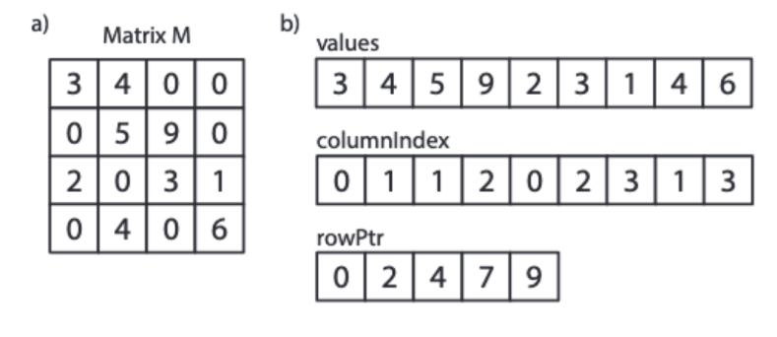
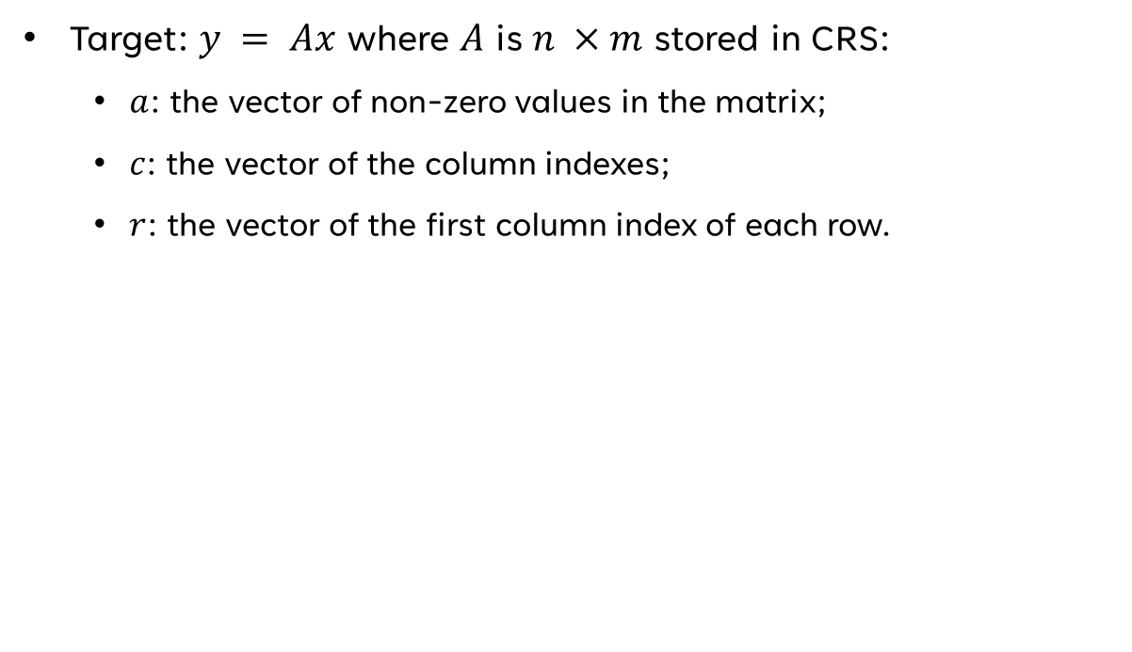
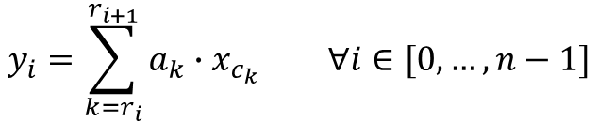
How does it work
Target: $y = Ax$ where $A$ is $n ×m$ stored in CRS:
$a$: the vector of non-zero values in the matrix;
$c$: the vector of the column indexes;
$r$: the vector of the first column index of each row.
$$y_{i}=\sum_{k=r_{i}}^{r_{i+1}}{a_{k}∙x_{c_{k}}} ∀i∈[0,…, n−1]$$

Slide 4
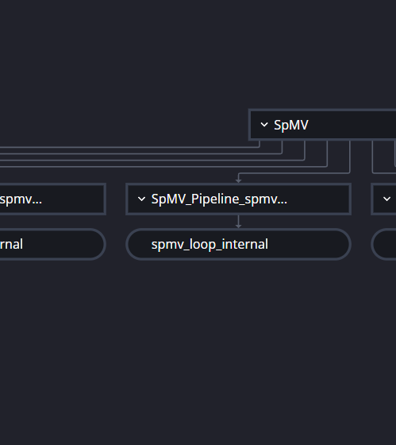
The algorithm

Slide 5
Pseudocode
for i = 0 to n – 1 do
y[i] = 0;
for k = r[i] to r[i+1] do
y[i] += a[k] * x[c[i]]
end for
end for

Slide 6

Implementation
spmv_loop_external:for(VectorSize i = 0; i < MAX_MATRIX_SIDE_SIZE; i++) {
#pragma HLS UNROLL int sum = 0; if(i < numOfRows) {
spmv_loop_internal:for(ValuesSize j = rowPointers[i]; j < rowPointers[i + 1]; j++) {
#pragma HLS PIPELINE II=1 int matrix_value = values[j];
ColumnIndex column_index = columnIndexes[j]; int vector_value = vector[column_index];
int temp = matrix_value * vector_value;
sum += temp;
} }
output[i] = sum;
}
Notes:
Unroll external loop into MAX_MATRIX_SIDE parallel units(loop count known at compile time) and activate each unit only if required
Single write per unit on the output
Pipelined with initiation interval = 1

Slide 7
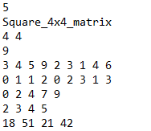
testbench
Testbench on text file.
Python testcase generator.
Load input
Load target
Call top function
Compare results

Slide 8
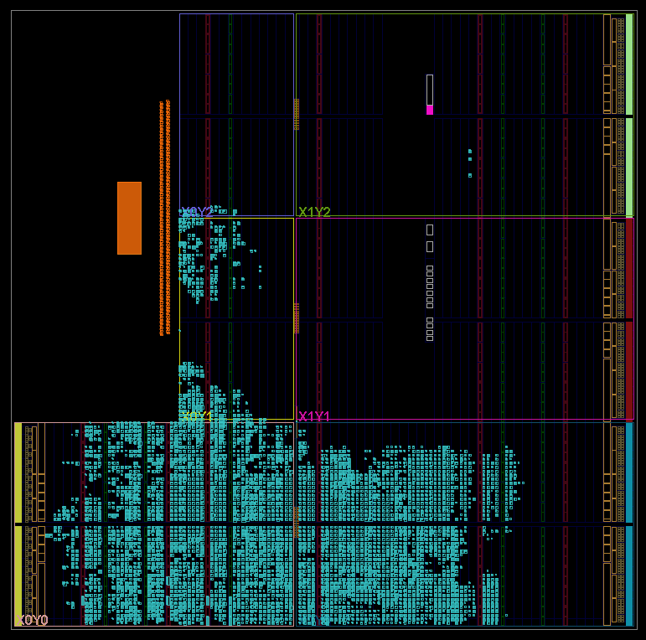
It’s bitstream time
Import IP
Block design
Synthesis
Implementation
Bitstream
Upload files to PYNQ

Slide 9
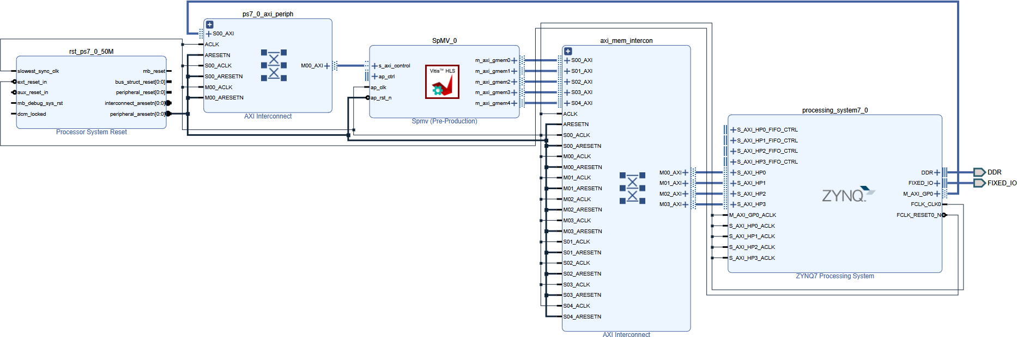
Block design
Notes:
The kernel parameters are sent over axilite
The kernel loads the data in the vectors from memory through high performance port

Slide 10
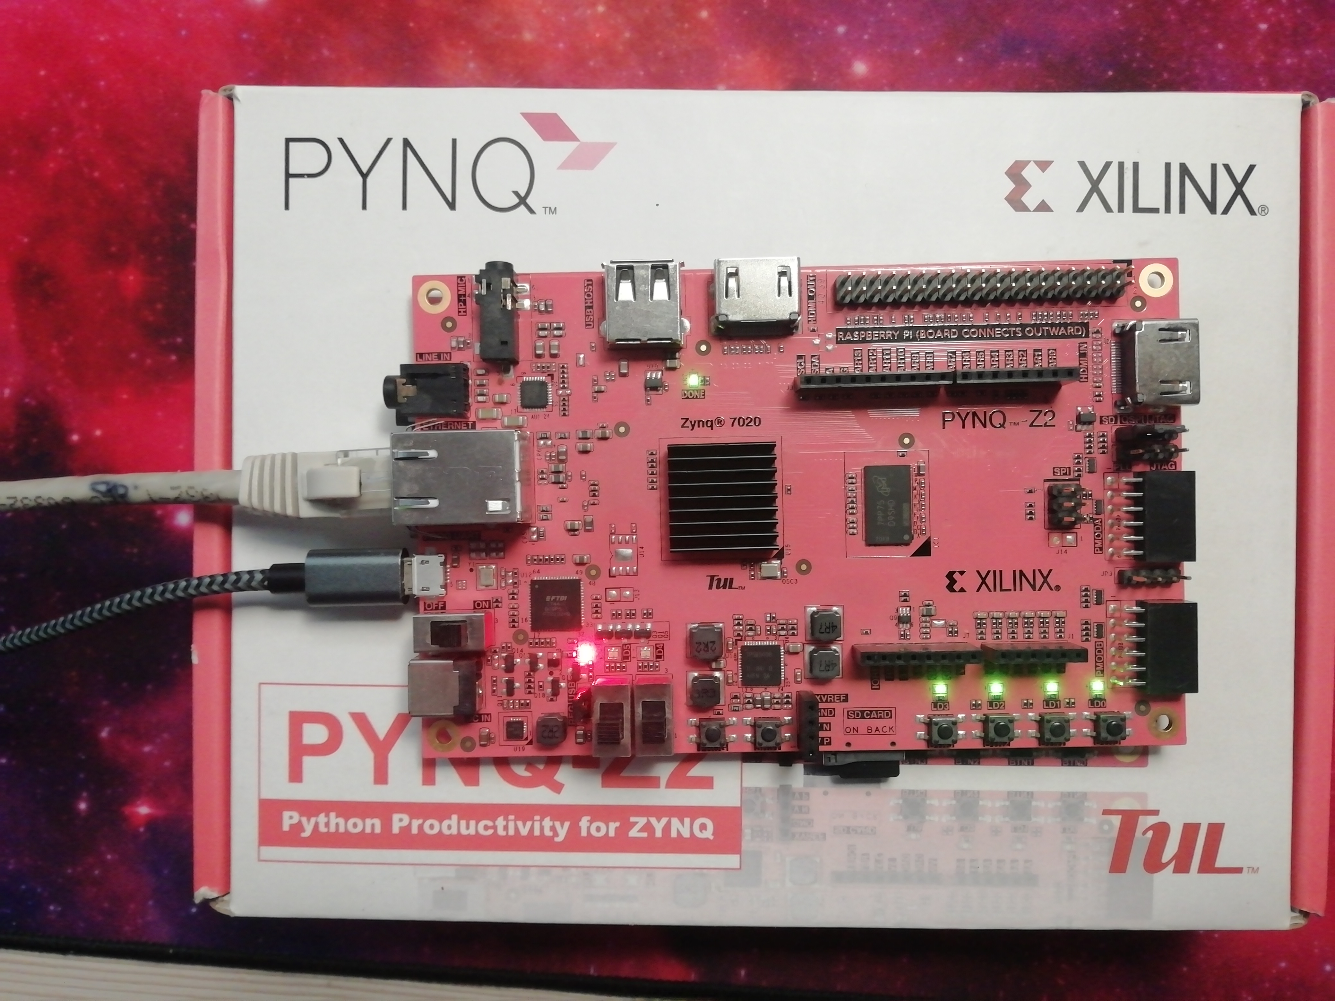


Using the kernel
Allocate buffers
Fill buffers
Write parameters
Start kernel
Wait for termination
Read result
Load overlay

Slide 11

thanks
Code, slides and report on GitHub
Notes:
Listening and for the course and everything

